Slide 1

Health care and life sciences
Prepared by
UMAIR AHMED E F
TEJA LAKKADASU
VISHAL KARTHICK R
MANNE VASU RAJENDRA
YOGESHWARAN V
Prediction of Diabetic Patient Readmission
Mentored by
Mr. Srikar Muppidi

Slide 2
Explanation of the Dataset
The Capstone project will present the analysis of a large clinical database that was undertaken to examine the historical patterns of diabetes care in patients with diabetes admitted to a US hospital and to indicate future directions which will lead to a reduction in hospital readmission rate and improvements in patient care.
The need for readmission indicates that inadequate care was provided to the patient at the time of first admission. Inadequate care poses threat to patients’ life and treatment of readmitted patients leads to increased healthcare costs.

Slide 3
Variable Information
S.no | Feature name | Description
1. | Encounter ID | Unique identifier of an encounter
2. | Patient Number | Unique identifier of a patient
3. | Race | Values: Caucasian, Asian, African American, Hispanic, and other
4. | Gender | Values: male, female, and unknown/invalid
5. | Age | Grouped in 10-year intervals: [0, 10), [10, 20), ..., [90, 100)
6. | Weight | Weight in pounds
7. | Admission Type | Integer identifier corresponding to 9 distinct values, for example, emergency, urgent, elective, new-born, and not available
8. | Discharge disposition | Integer identifier corresponding to 29 distinct values, for example, discharged to home, expired, and not available

Slide 4
S.no | Feature name | Description
9. | Admission source | Integer identifier corresponding to 21 distinct values, for example, physician referral, emergency room, and transfer from a hospital
10. | Time in hospital | Integer number of days between admission and discharge
11. | Payer Code | Integer identifier corresponding to 23 distinct values, for example, Blue Cross\Blue Shield, Medicare, and self-pay
12. | Medical Speciality | Integer identifier of a specialty of the admitting physician, corresponding to 84 distinct values, for example, cardiology, internal medicine, family\general practice, and surgeon
13. | Number of Outpatient visits | Number of outpatient visits in the year preceding the encounter
14. | Number of lab procedures | Number of lab tests performed during encounter

Slide 5
S.no | Feature name | Description
15. | Number of procedures | Number of procedures (other than lab tests) performed during the encounter
16. | Number of Medications | Number of distinct generic names administered during the encounter
17. | Number of emergency visits | Number of emergency visits of the patient in the year preceding the encounter
18 | Number of inpatient visits | Number of inpatient visits of the patient in the year preceding the encounter
19. | Diagnosis 1 | The primary diagnosis (coded as first three digits of ICD9) 848 distinct values
20. | Diagnosis 2 | Secondary diagnosis (coded as first three digits of ICD9); 923 distinct values
21. | Diagnosis 3 | Additional secondary diagnosis (coded as first three digits of ICD9); 954 distinct
22. | Number of Diagnoses | Number of diagnoses entered in the system
23. | Glucose serum test result | Indicates the range of the result or if the test was not taken. Values: “>200,” “>300,” “normal,” and “none” if not measured

Slide 6
S.no | Feature name | Description
24. | A1c test result | Indicates the range of the result or if the test was not taken. Values: “>8” if the result was greater than 8%, “>7” if the result was greater than 7% but less than 8%, “normal” if the result was less than 7%, and “none” if not measured
25. | Change of medications | Indicates if there was a change in diabetic medications (either dosage or generic name). Values: “change” and “no change”
26. | Diabetics medication | Indicates if the there was any diabetic medication prescribed. Values: “yes” and “no”
27. | 24 features for medication | For the generic names: metformin, repaglinide, nateglinide, chlorpropamide, glimepiride, acetohexamide, glipizide, glyburide, tolbutamide, pioglitazone, rosiglitazone, acarbose, miglitol, troglitazone, tolazamide, examide, sitagliptin, insulin, glyburide-metformin, glipizide-metformin, glimepiride-pioglitazone, metformin-rosiglitazone, and metformin-pioglitazone, the feature indicates whether the drug was prescribed or there was a change in the dosage. Values: “up” if the dosage was increased during the encounter, “down” if the dosage was decreased, “steady” if the dosage did not change, and “no” if the drug was not prescribed

Slide 7
Target Variable
S.no | Feature name | Description
28. | Readmitted | Days to inpatient readmission. Values: “<30” if the patient was readmitted in less than 30 days, “>30” if the patient was readmitted in more than 30 days, and “No” for no record of readmission

Slide 8
Problem Statement
Patients facing a high risk of readmission need to be identified at the time of being discharged from the hospital, to facilitate improved treatment to reduce the chances of their readmission.
Readmission of patients within 30 days of being discharged (short-term readmission) and those with more than 30 days of readmission has been a widely used metric for studying re-admissions.
This project aims to carry out the use cases of “Binomial classification” by combining both types of readmissions for research purposes to check the efficiencies of the different ML algorithms.

Slide 9
Univariate analysis
Health care and life sciences

Slide 10
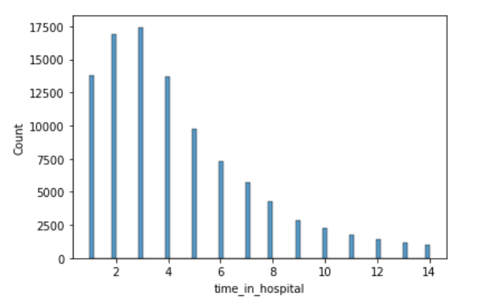
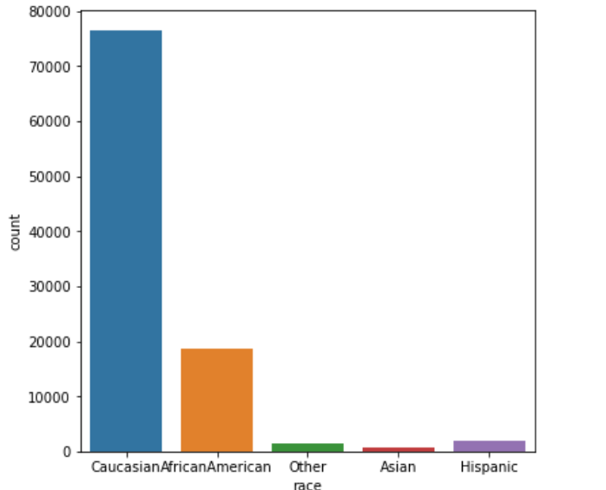
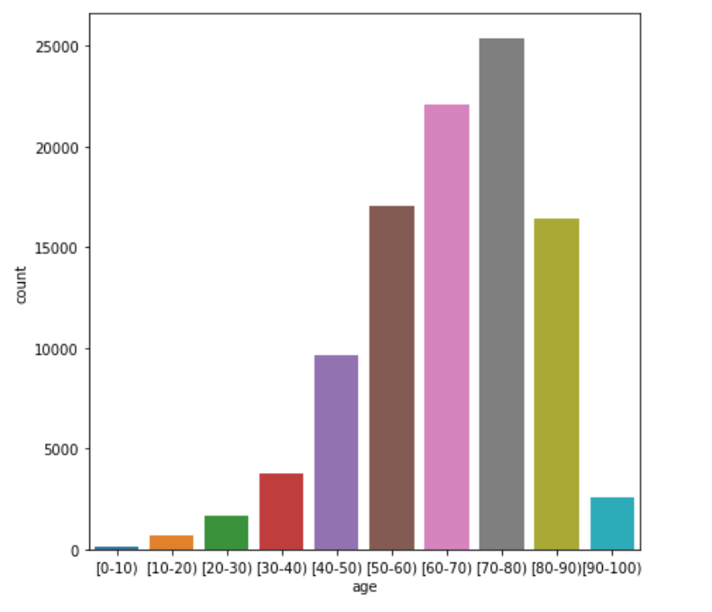
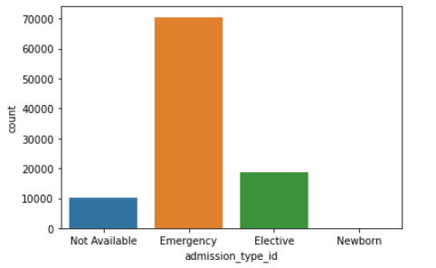
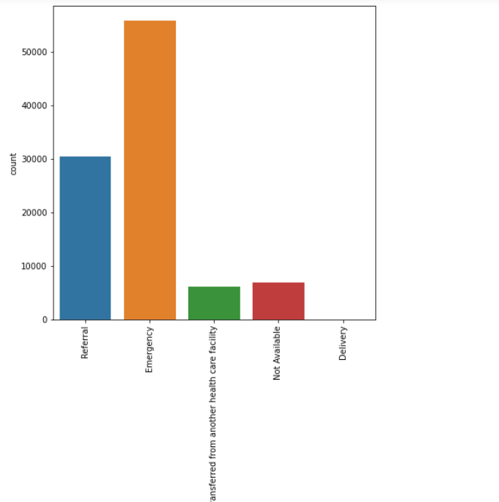
Time in hospital
Race
Age
Admission Type id
Admission Source ID

Slide 11
Bivariate analysis
Health care and life sciences

Slide 12
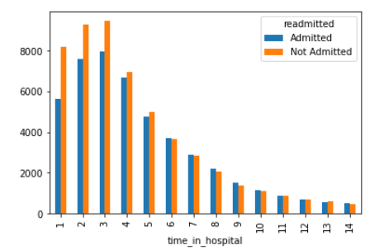
Time in hospital vs Distribution of Readmission
The maximum probability of the patients who stayed in the hospital is 3 days.
The number of patients who are not admitted as well as stayed in the hospital more than 30 days is more

Slide 13
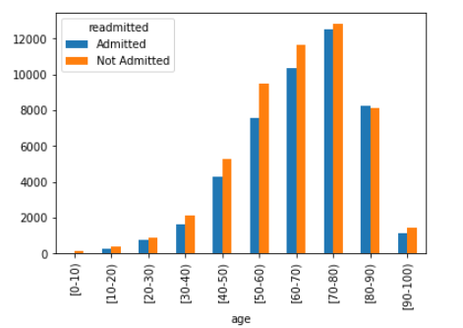
Age of Patient vs Readmission
Patients above the age of 60 are highly prone to diabetics

Slide 14
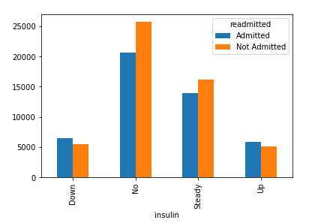
Insulin, Readmitted (count):
The level of insulin was steady for nearly 25000 patients overall.
The patients who were not administered with insulin are highly likely not to be readmitted.

Slide 15
Baseline model
Health care and life sciences

Slide 16
Baseline model
After cleaning the initial dataset and post dummy encoding the variables, we have 106 columns with 99337 data rows. So, we proceeded to build a few base models using Logistic Regression, Random Forest on this data without scaling or transformation or hyperparameter tuning until the model performance scores are in acceptable range. Below is the data frame consisting of all the scores.
In this section, we will first compare the performance of the following 2 machine learning models using default hyperparameters:
LOGISTIC REGRESSION
RANDOM FOREST

Slide 17
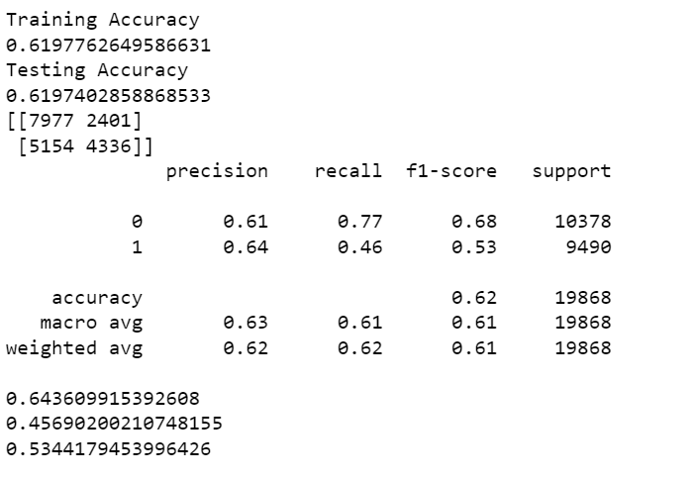
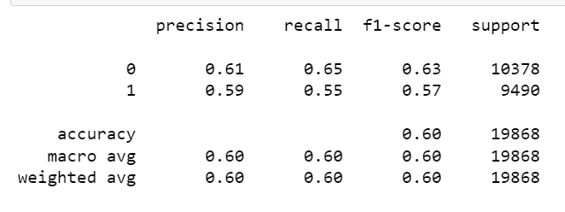
LOGISTIC REGRESSION
MODEL ACCURACY
RANDOM FOREST
MODEL ACCURACY
Based on the Domain we are working with, Recall Evaluation metric is considered
Recall: 0.77 for not admitted
Recall: 0.46 for admitted
Recall: 0.65 for not admitted
Recall: 0.55 for admitted

Slide 18
Future work
Health care and life sciences

Slide 19
Future work:
Treating the outliers and treating multicollinearity with VIF.
Scaling and Transformation for modelling.
Revisiting Feature engineering /Feature selection process.
Implementing various classification algorithms for the best model selection
Use Ensemble techniques to improve the model performance
Hyperparameter Tuning.
Robust Model Evaluation.
Improving Precision and Recall Scores for Minority class.

Slide 20
Thank you

